Slide 1
Computer Graphics: Line Drawing Algorithms
Scan Conversion Algorithms
(Midpoint Line)

Slide 2
7
6
5
4
Midpoint
3
2
0
1
2
3
4
5
6
7

Slide 4




(2, 4)
(2, 3)
(2, 2)

Slide 5



Slide 8
f(M) | Pixel chosen
f(M) > 0 | upper (NE)
f(M) ≤ 0 | lower (E)

Slide 9









Slide 10







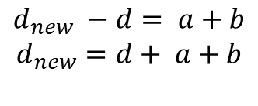
Assume,

Slide 11












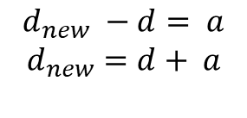
Again assume,

Slide 12
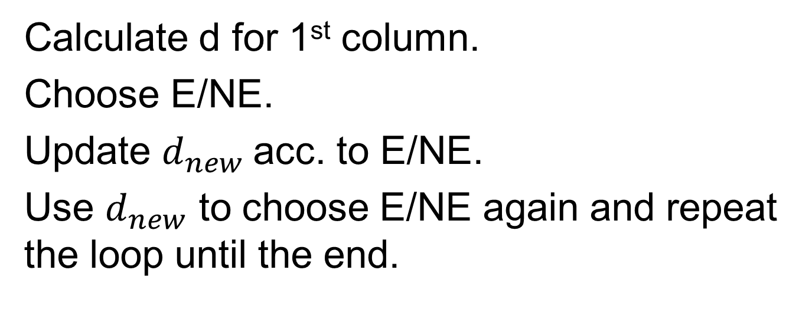

Slide 13
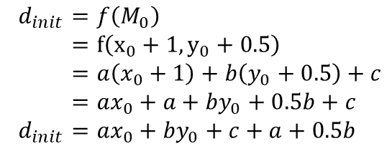
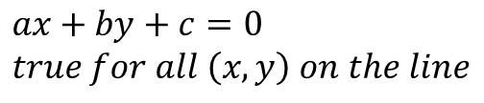



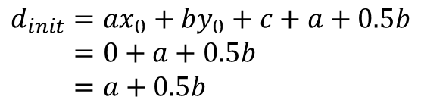
7
6
5
4
Midpoint
3
2
0
1
2
3
4
5
6
7

Slide 14





yes
no
no
yes
end

Slide 15

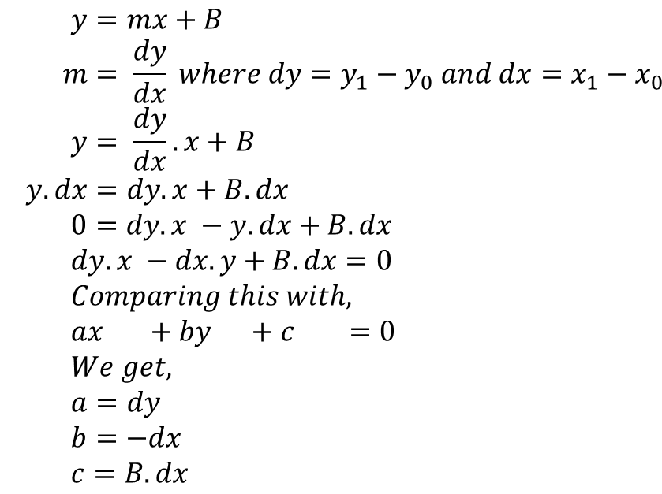



Slide 16
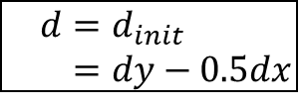
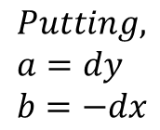
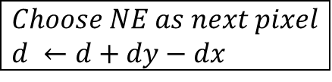
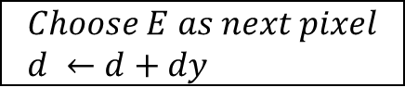
yes
no
no
yes
end

Slide 17
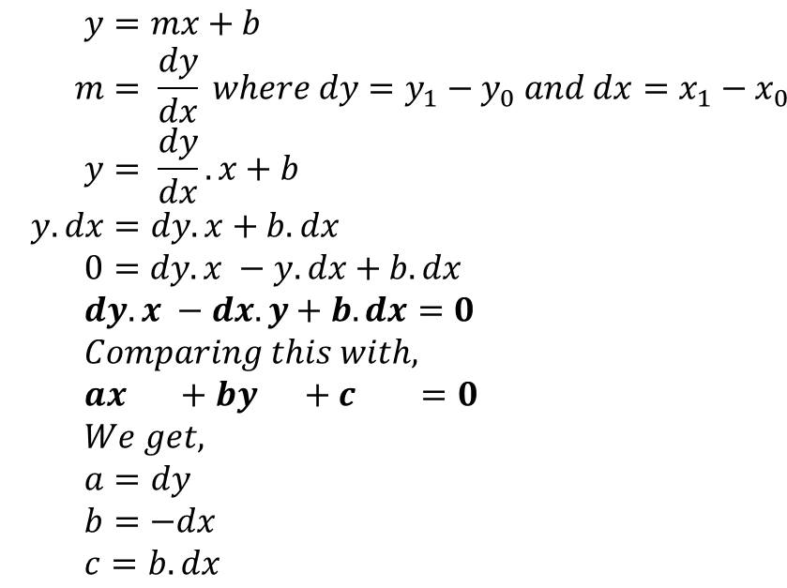
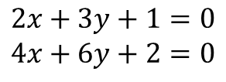

Slide 18
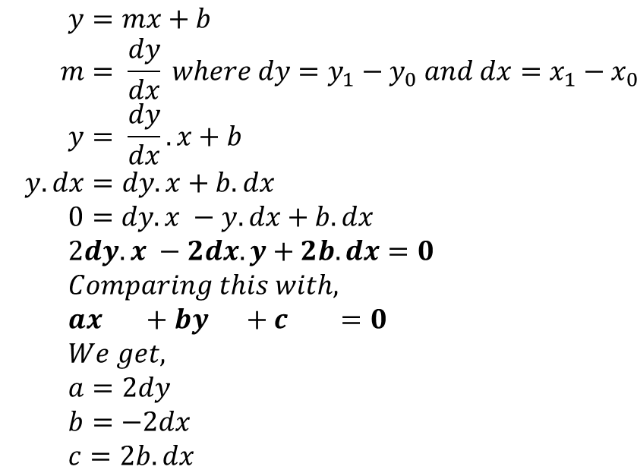

Slide 19
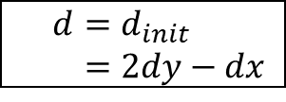
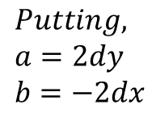
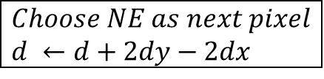
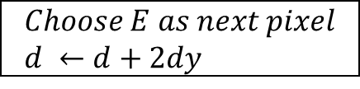
yes
no
no
yes
end

Slide 20
func MidpointLine(int x0, int y0, int x1, int y1, int value){
int dx, dy, incrE, incrNE, d, x, y;
dx = x1 -x0;
dy = y1 -y0;
d = 2 * dy - dx;
incrE = 2 * dy;
incrNE = 2 * (dy - dx);
x = x0;
y = y0;
WritePixel (x, y, value);
while (x < x1) {
if (d <= 0) {
//choose E
d = d + incrE;
x = x + 1;
}
else {
//choose NE
d = d + incrNE;
x = x + 1;
y = y + 1;
}
WritePixel (x,y, value) //The selected pixel closest to the line
}
}

Slide 21
Find out the first 7 pixels of the line segment starting from (0, 2) to (70, 52) using midpoint line algorithm

Slide 22
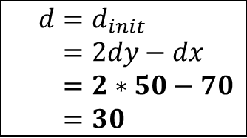
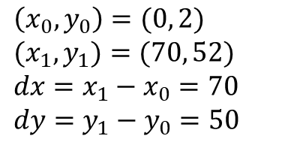
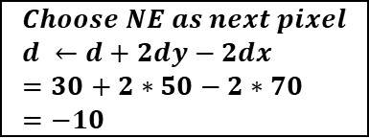
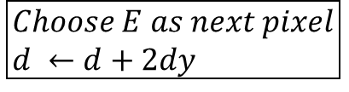
yes
no
no
yes
end

Slide 23
x | y | d | NE(+1,+1)/E(+1,0) | d updating | Pixel
0 | 2 | 30 | NE | 30+2x50-2x70 = -10 | (0, 2)
1 | 3

Slide 24
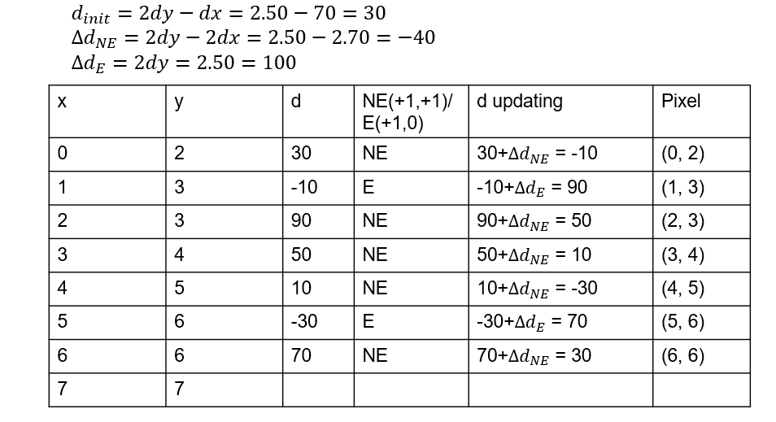
Decision for Next Pixel

Slide 25
Midpoint Line Drawing Algorithm
Midpoint (x₁, y₁, x₂, y₂){
dx= x₂ - x₁ ; dy = y₂ - y₁ ;
D = 2*dy – dx; ∆NE = 2*(dy-dx) ; ∆E = 2*dy ;
x= x₁ ; y = y₁ ;
while( x ≤ x₂){
Draw(x, y);
x++ ;
if (D>0){
y++;
D = D+ ∆NE ;
}
else{
D = D+ ∆E ;
}
}
}

Slide 26
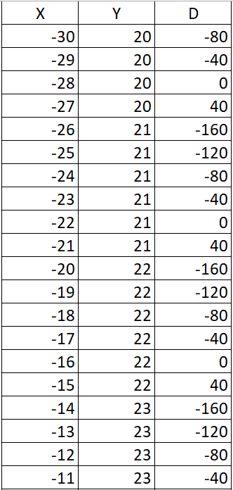
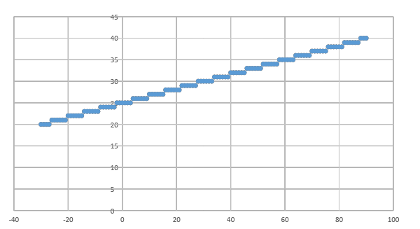
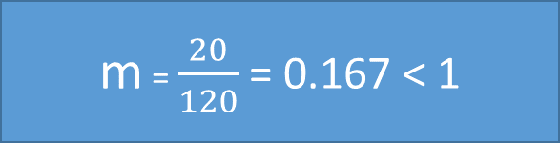
(-30, 20) to (90, 40)
dx= 90 + 30 = 120 ; dy = 40- 20 = 20;
D = 2*20 – 120 = -80; ∆NE = 2*(20-120) = -200 ; ∆E = 2*20 = 40;

Slide 27
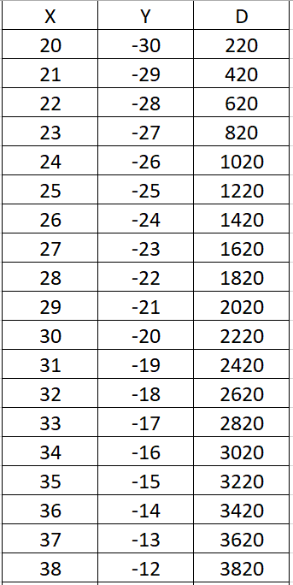
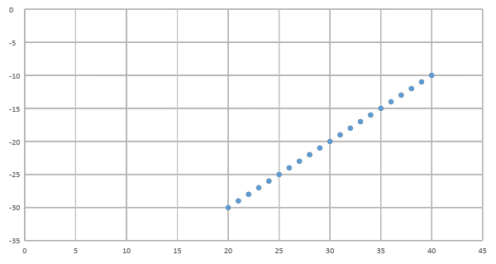

(20, -30) to (40, 90)
dy= 90 + 30 = 120 ; dx = 40- 20 = 20;
D = 2*120 – 20 = 220; ∆NE = 2*(120-20) = 200 ; ∆E = 2*120 = 240;

Slide 28
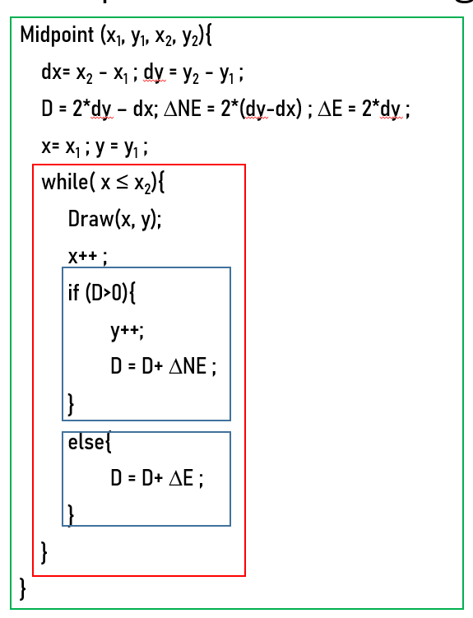
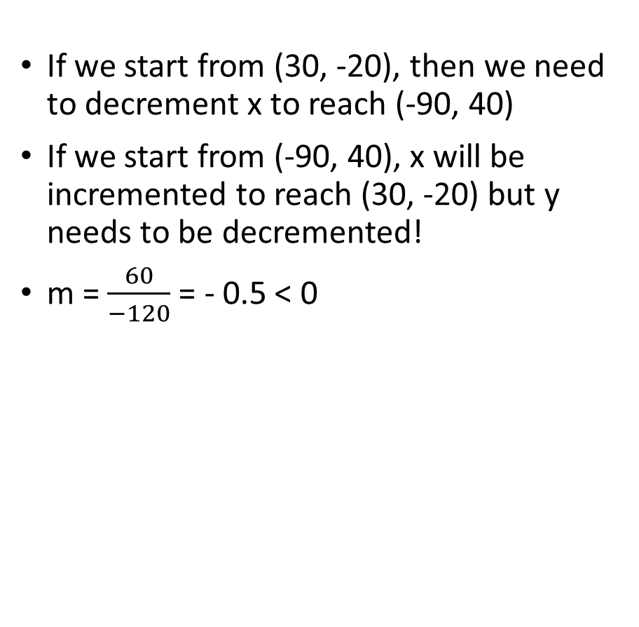
(30, -20) to (-90, 40)

Slide 29
x₁, y₁
Midpoint Line Drawing Algorithm
Coordinates (x, y) of points on the line
x₂, y₂

Slide 30
Eight-way Symmetry
Check this article to understand 8-way symmetry:
https://studyresearch.in/bresenhams-circle-algorithm/

Slide 31
How to find Zone?
Zone: 2
dx<0, dy>0, |dy|>|dx|
Zone: 1
dx>0, dy>0, |dy|>|dx|
FindZone(x₁, y₁, x₂, y₂){
dx= x₂ - x₁ ; dy = y₂ - y₁ ;
if(|dx| > |dy|){
if(dx>0 && dy>0) zone = 0;
else if(dx<0 && dy>0) zone =3;
else if (? ?) zone = ? ;
else if (? ?) zone = ?
}
else{
if(dx>0 && dy>0) zone = 1;
else if(dx<0 && dy>0) zone =2;
else if (? ?) zone = ? ;
else if (? ?) zone = ?
}
}
Zone: 3
dx<0, dy>0, |dx|>|dy|
Zone: 0
dx>0, dy>0, |dx|>|dy|
Zone: 4
?
Zone: 7
?
Zone: 5
?
Zone: 6
?

Slide 32
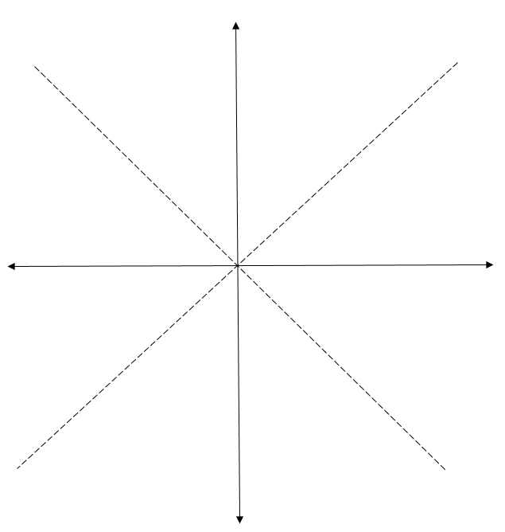
2
1
3
0
(100, 35)
4
7
(-50, -15)
5
6

Slide 33
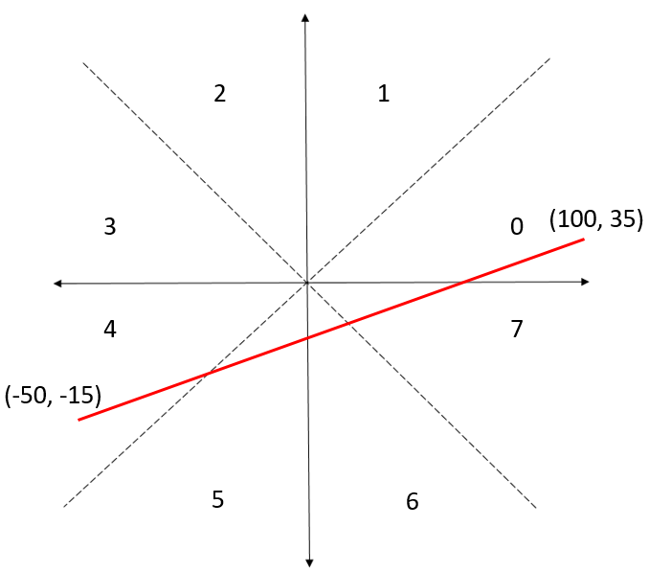
dx = 100 + 50 = 150 > 0
dy = 35 + 15 = 50 > 0
|dx| > |dy|
Zone = 0

Slide 34
How do we utilize the zones?

Slide 35
Input (x₁, y₁) to (x₂,y₂) for a line of Zone M, where M ={0, 1, …, 7}
FindZone
Convert the coordinates of a line in Zone M into the coordinates of a line in Zone 0
?
Use the existing midpoint line drawing algorithm for Zone 0
MidPoint
Convert the points (x, y) back to original Zone M
?

Slide 36
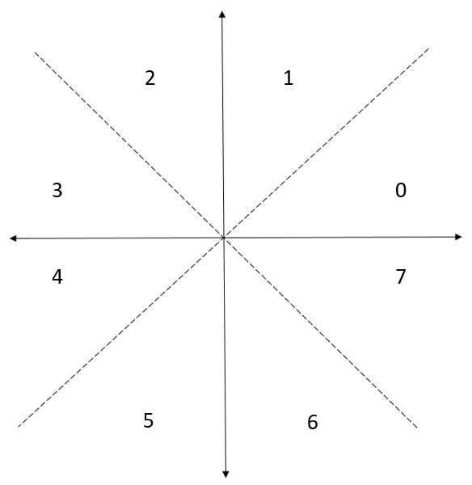
Convert the coordinates of Zone M into the coordinates of Zone 0 Zone 1 → Zone 0
Coordinates in Zone 1: ( X, Y ) becomes (Y , X) in Zone 0
(5, 50)
ConvertToZone0 (X, Y, zone){
if (zone == 1){
x = Y, y = X
}
return (x, y)
}
(50, 5)

Slide 37
Convert the coordinates of Zone M into the coordinates of Zone 0 Zone 2 → Zone 0
Coordinates in Zone 2: ( X, Y ) becomes (Y , - X) in Zone 0
(-5, 50)
ConvertToZone0 (X, Y, zone){
if (zone == 1){
x = Y, y = X
}
else if (zone ==2){
x = Y, y = -X
}
return (x, y)
}
(50, 5)

Slide 38
Convert the coordinates of Zone M into the coordinates of Zone 0 Zone 3 → Zone 0
Coordinates in Zone 3: ( X, Y ) becomes (-X, Y) in Zone 0
ConvertToZone0 (X, Y, zone){
if (zone == 1){
x = Y, y = X
}
else if (zone ==2){
x = Y, y = -X
}
else if (zone ==3){
x = -X , y = Y
}
….
return (x, y)
}
(-50, 5)
(50, 5)
DIY for zone 4, 5, 6, 7

Slide 39
Input (x₁, y₁) to (x₂,y₂) for a line of Zone M, where M ={0, 1, …, 7}
FindZone
Convert the coordinates of a line in Zone M into the coordinates of a line in Zone 0
ConvertToZone0
Use the existing midpoint line drawing algorithm for Zone 0
MidPoint
Convert the points (x, y) back to original Zone M
?

Slide 40
Go back to original zone M Zone 0 → Zone 1
Coordinates in Zone 0: ( X, Y ) becomes (Y , X) in Zone 1
(5, 50)
OriginalZone (X, Y, zone){
if (zone == 1){
x = Y, y = X
}
return (x, y)
}
(50, 5)

Slide 41
Go back to original zone M Zone 0 → Zone 2
Coordinates in Zone 0: ( X, Y ) becomes (-Y , X) in Zone 2
(-5, 50)
OriginalZone (X, Y, zone){
if (zone == 1){
x = Y, y = X
}
else if(zone == 2){
x = -Y, y = X
}
return (x, y)
}
(50, 5)

Slide 42
Go back to original zone M Zone 0 → Zone 3
Coordinates in Zone 0: ( X, Y ) becomes (-X , Y) in Zone 3
OriginalZone (X, Y, zone){
if (zone == 1){
x = Y, y = X
}
else if(zone == 2){
x = -Y, y = X
}
else if (zone ==3){
x = -X , y = Y
}
….
return (x, y)
}
(-50, 5)
(50, 5)
DIY for zone 4, 5, 6, 7

Slide 43
Input (x₁, y₁) to (x₂,y₂) for a line of Zone M, where M ={0, 1, …, 7}
FindZone
Convert the coordinates of a line in Zone M into the coordinates of a line in Zone 0
ConvertToZone0
Use the existing midpoint line drawing algorithm for Zone 0
MidPoint
Convert the points (x, y) back to original Zone M
OriginalZone

Slide 44
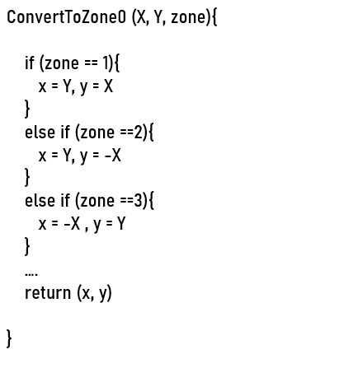
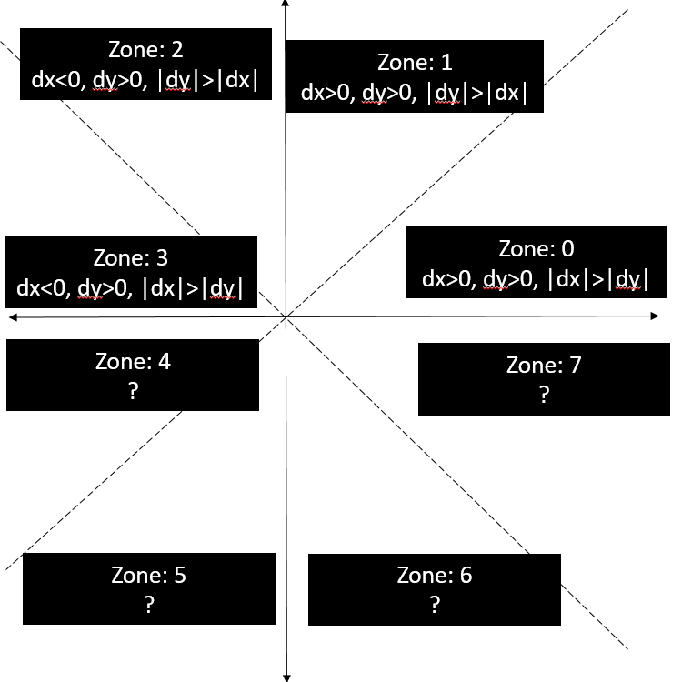
Sample Problem and Step by Step Solution
Find first 7 pixels of the line having endpoints (-10,-20) and (-20, 70)
Step 1 (Find out the Zone):
dx = -20 +10 = -10 < 0
dy = 70 + 20 = 90 > 0
|dy| > |dx|,
So, Zone = 2
Step 2 (Convert to Zone 0):
Zone = 2, so, (x = Y, y = -X)
Start: (-10, -20) → (-20, 10)
End: (-20, 70) →(70, 20)
So, new endpoints in Zone 0: (-20, 10) and (70, 20)

Slide 45
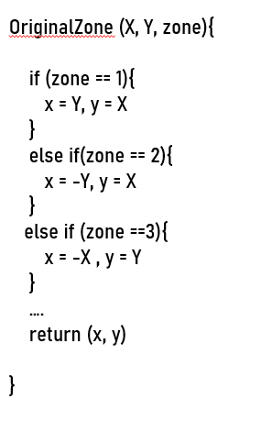
Step 3 (Apply MPL for Zone 0):
dx’ = 70 + 20 = 90,
dy’ = 20 - 10 = 10,
D = 2*10 - 90 = -70,
∆NE = 2*(10-90) = -160,
∆E = 2*10 = 20
Step 4 (Convert to Original Zone):
Orange Colored X’ and Y’ are in Zone 0,
Now, Convert back to Original Zone
Here, Original Zone = 2, So, (x = -Y, y = X) ,
Green Colored Part is the actual Pixels (X, Y)
Pixels (in Zone 2)
X = -Y’ | Y = X’
-10 | -20
-10 | -19
-10 | -18
-10 | -17
-10 | -16
-11 | -15
-11 | -14
X’ | Y’ | D | E/NE | Updating D
-20 | 10 | -70 | E | -50
-19 | 10 | -50 | E | -30
-18 | 10 | -30 | E | -10
-17 | 10 | -10 | E | 10
-16 | 10 | 10 | NE | -150
-15 | 11 | -150 | E | -130
-14 | 11 | -130 | E | -110

Slide 46


Unfortunately NO!!
So, No More Staircasing Effect???

Slide 47
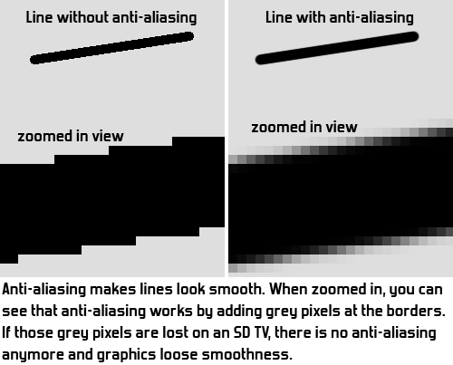
Aliasing and Antialiasing
Aliasing
Approximating a continuous entity with discrete samples
Jagging / staircasing effect
Result of an all-or-nothing approach to scan conversion
Each pixel is either colored or left unchanged
Antialiasing
The application of techniques that reduce or eliminate aliasing. Eg. Unweighted Area Sampling

Slide 48
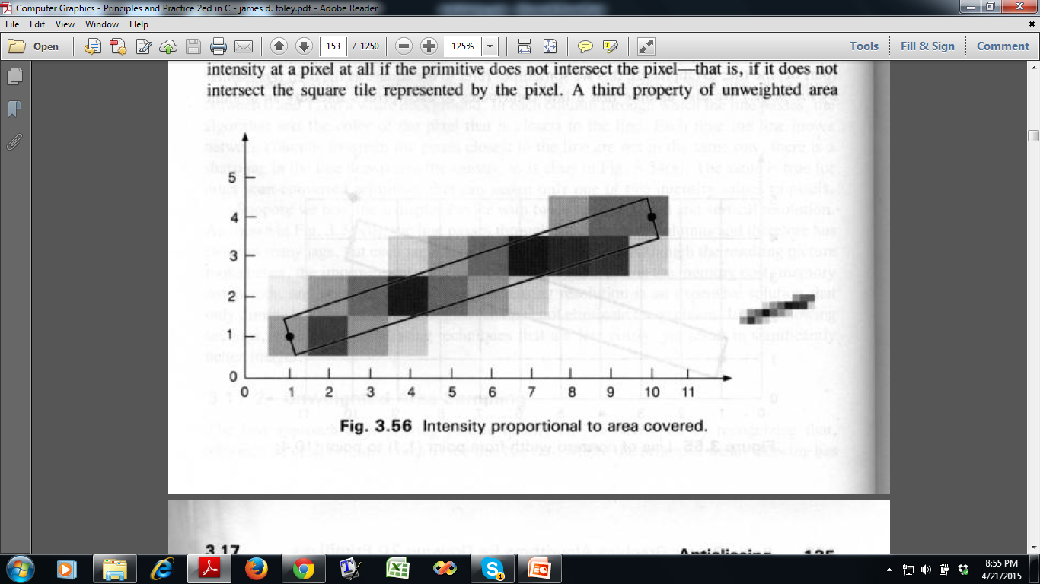
Unweighted Area Sampling
Basic Idea:
Pixels on the grid overlapped by the rectangle are colored to an appropriate intensity. General rule : A line contributes to each pixel’s intensity an amount proportional to the percentage of the pixel’s tile it covers.
75%
25%
95%

Slide 49
Reference
Computer Graphics: Principles and Practice: John F. Hughes, James D. Foley, Andries van Dam, Steven K. Feiner (2nd Edition)
Chapter: 3.2

